Slide 1

STUDENT RECORD MANAGEMENT SYSTEM
TEAM MEMBERS:
K. MOUNIKA
197210
A.KRISHNA DEEPTHI
197265
M. VIJAYA LAKSHMI
197266
B. DEVIKA
197270

Slide 2
CONTENTS
ABSTRACT
ENXISTING SYSTEM AND DRAWBACKS
PROPOSED SYSTEM AND MERITS
HARDWARE COMPONENTS AND SOFTWARE REQUIREMENTS
SOFTWARE REQUIRMENTS SEPCIFICATIONS(SRS DOCUMENT)
(FUNTIONAL AND NON FUNCTIONAL REQUIREMENTS INCLUDED.)
DATA DICTIONARY
USE CASE DIARGRAM
CLASS DIAGRAM
SEQUENCE DIAGRAM
ACTIVITY DIAGRAM
OUTPUTS SCHREEN SHOTS
TESTCASES
CONCLUSION
FUTURESCOPE
BIBILIOGRAPHY
D
A
T
A
Is life

Slide 3
ABSTRACT
“STUDENT RECORD MANAGEMENT SYSTEM” is to alter the hand-operated student record system with the computerized program. This system enhances the convenience of maintaining student information. Student record system assists the users in quick management of the information with a user-friendly interface provided.

Slide 4
EXISTING SYSTEM AND DRAWBACKS
Records of the students are submitted to the authority of the institute. Marks and attendance of the students are also recorded manually by the faculty.
The students with attendance less than 75% are informed at last via SMS.
Time Consuming and difficult for report generating.
2
Proper Storage Facility is needed.
3
The Data is not Accessible Constantly.
4
Security of the Records.
5
A lot of pen and paper work is required, not User-Friendly
1

Slide 5
PROPOSED SYSTEM AND MERITS
The project “Student record management system” is a web-application developed for the proper accessibility of data within no time.
It is provided with the functionalities of inserting, manipulating and retrieving the records of the student.
This system also supports in securely storing the consistent data for great lengths of time.
User-friendly.
Quick management of work
Proper Accessibility of data.
Reports are generated easily.
STUDENT RECORD MANAGEMENT SYSTEM

Slide 6
SOFTWARE REQUIREMENTS:
Hardware components:
RAM – 300 MB
HARD DISK – 40 GB
PROCESSOR – Intel
OPERATING SYSTEM - Windows
PYTHON
The logic is implemented in python programming language
DJNAGO
Django framework is used to develop the project
All the records are stored in SQL database
HTML
CSS
The layout of the webpages are developed in HTML
The webpages are designed using CSS.
JAVA SCRIPT
SQL
Java Script is for the behavior of the web pages

Slide 7
SRS DOCUMENT

Slide 8
FUNCTIONAL REQUIRMENTS
1.
2.
3.
4.
5.
Student viewing the details, marks, attendance and report.
Users accessing the system with a proper valid login detail.
Submission and accessing of student details and certificates.
Submission and updating of marks and attendance by the teacher.
Report generation for attendance and marks.
NON-FUNCTIONAL REQUIRMENTS
Security
Performance
User-friendly
Manageability
Availability.

Slide 9
DATA DICTIONARY
Attributes | Datatype | length | Primary key | nullable | Unique
First_Name | Varchar | 30 | False | False | False
Last_Name | Varchar | 30 | False | False | False
Class | Varchar | 10 | False | False | False
Group | Varchar | 10 | False | False | False
Section | Varchar | 1 | False | False | False
Admission_Number | Integer | 4 | False | False | True
Roll_number | Integer | 6 | True | False | True
Date_of_birth | Date | None | False | False | False
Gender | Varchar | 10 | False | False | False
Father_name | Varchar | 50 | False | True | False
Mother_name | Varchar | 50 | False | True | False
Guardian_name | Varchar | 50 | False | True | False
Religion | Varchar | 20 | False | False | False
Nationality | Varchar | 20 | False | False | False
Aadhaar_number | Varchar | 9 | False | False | True
Mobile_number | Varchar | 10 | False | False | True

Slide 10
Attributes | Datatype | length | Primary key | nullable | Unique
Alternate Mobile_number | Varchar | 10 | False | True | True
Email_id | Varchar | 256 | False | False | True
Door_number | Varchar | 10 | False | False | False
Premises | Varchar | 50 | False | True | False
Street | Varchar | 30 | False | True | False
City | Varchar | 30 | False | False | False
State | Varchar | 30 | False | False | False
Country | Varchar | 20 | False | False | False
Pin code | Varchar | 10 | False | False | False
Student_Image | Image | Less than 300 kb | False | False | True
Study_Of_Conduct | Image | Less than 300 kb | False | False | True
Transfer_Certificate | Image | Less than 300 kb | False | False | True
Tenth_Marks_Long _Memo | Image | Less than 300 kb | False | False | True
Intermediate_Marks _Short_Memo | Image | Less than 300 kb | False | False | True
Student_Signature | Image | Less than 300 kb | False | False | True

Slide 11
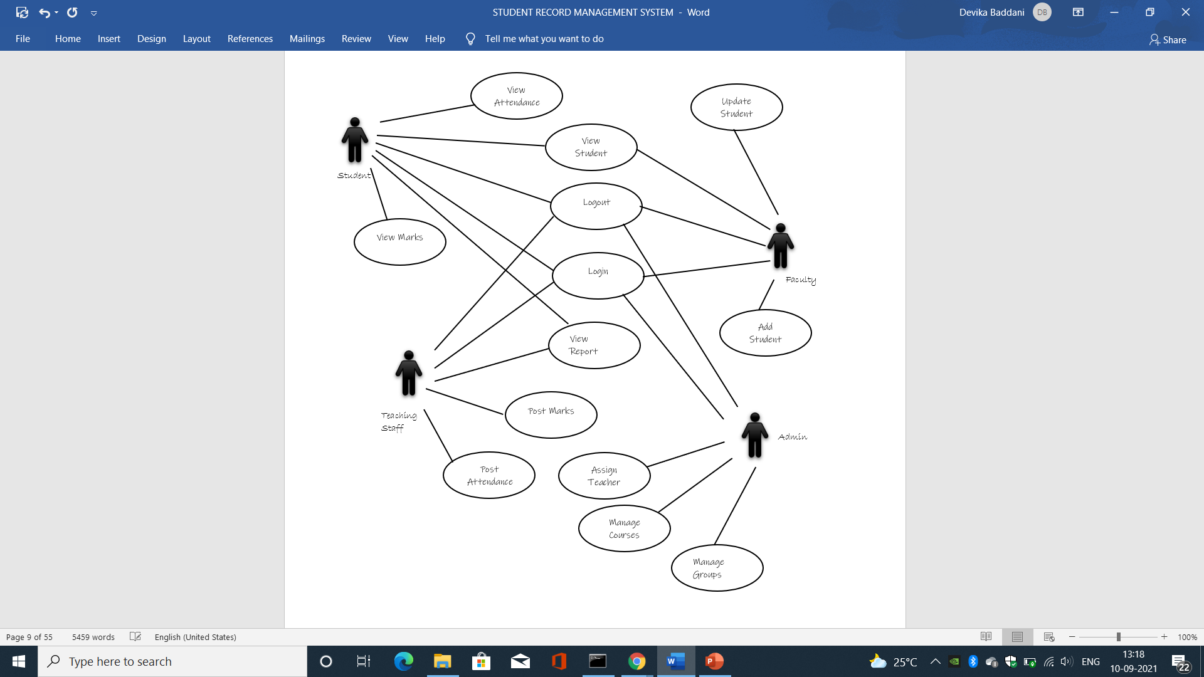
U
S
E
C
A
S
E
D
I
A
G
R
A
M

Slide 12
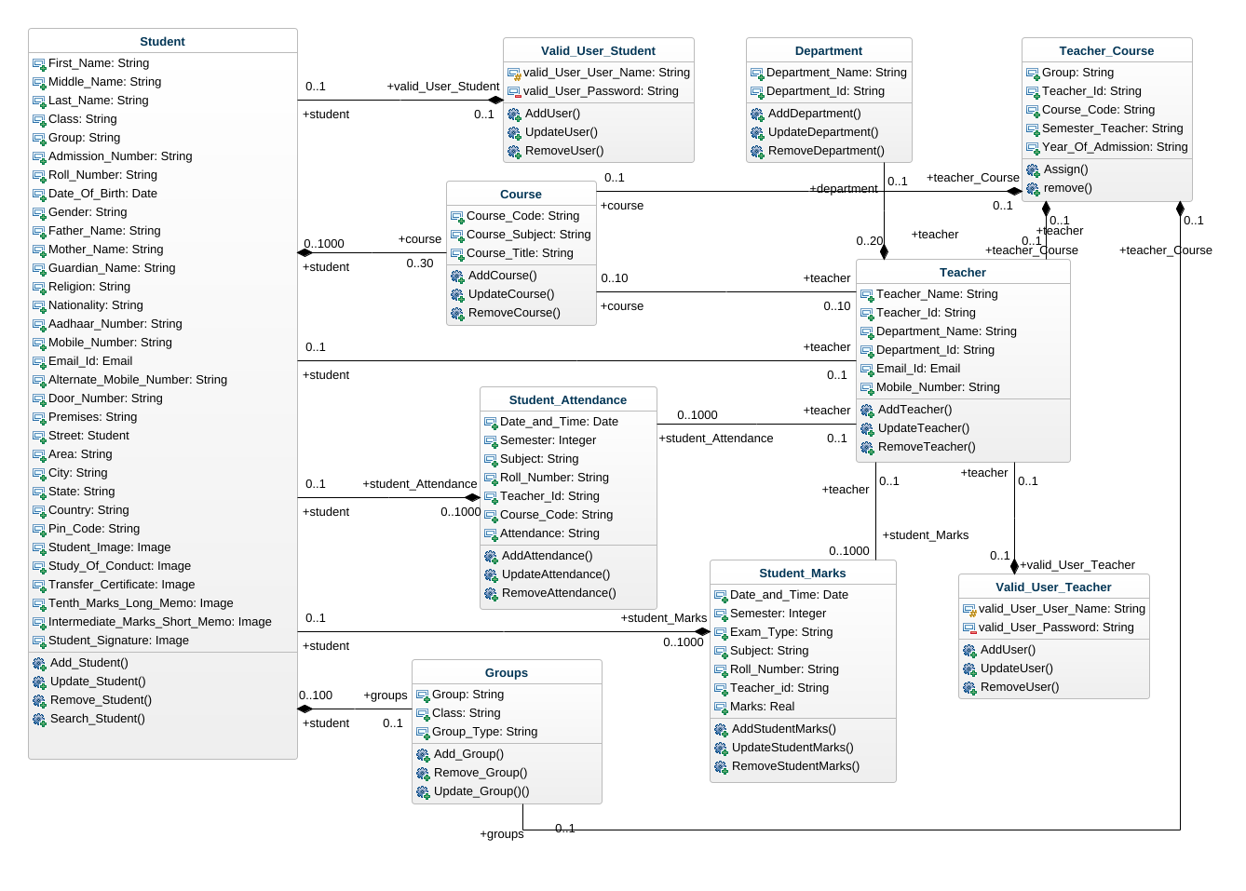
C
L
A
S
S
D
I
A
G
R
A
M

Slide 13
STUDENT
TEACHER
FACULTY
S
E
Q
U
E
N
C
E
D
I
A
G
R
A
M
LOGIN SUCCESSFUL
STUDENT DETAILS
ATTENDANCE
MARKS
LOGIN TO PAGE
ADD/UPDATE/DELETE/
VIEW/REMOVE DETAILS
MANAGE STUDENT DETAILS
POST/
UPDATE/
VIEW/REMOVE
MANAGE ATTENDANCE
POST/
UPDATE/
VIEW/REMOVE
MARKS
MANAGE MARKS
VIEW DETAILS
VIEW ATTENDANCE
VIEW MARKS

Slide 14
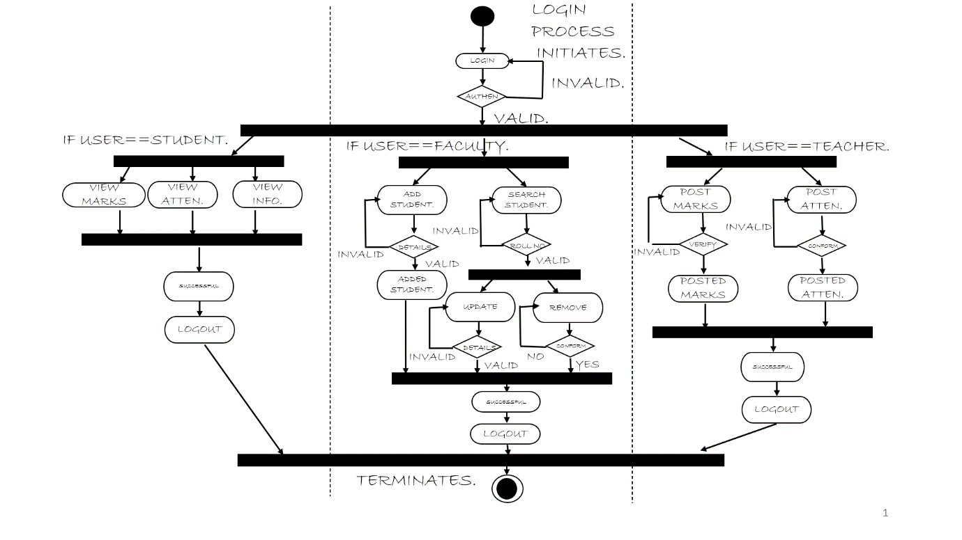
A
C
T
I
V
I
T
Y
D
I
A
G
R
A
M

Slide 15
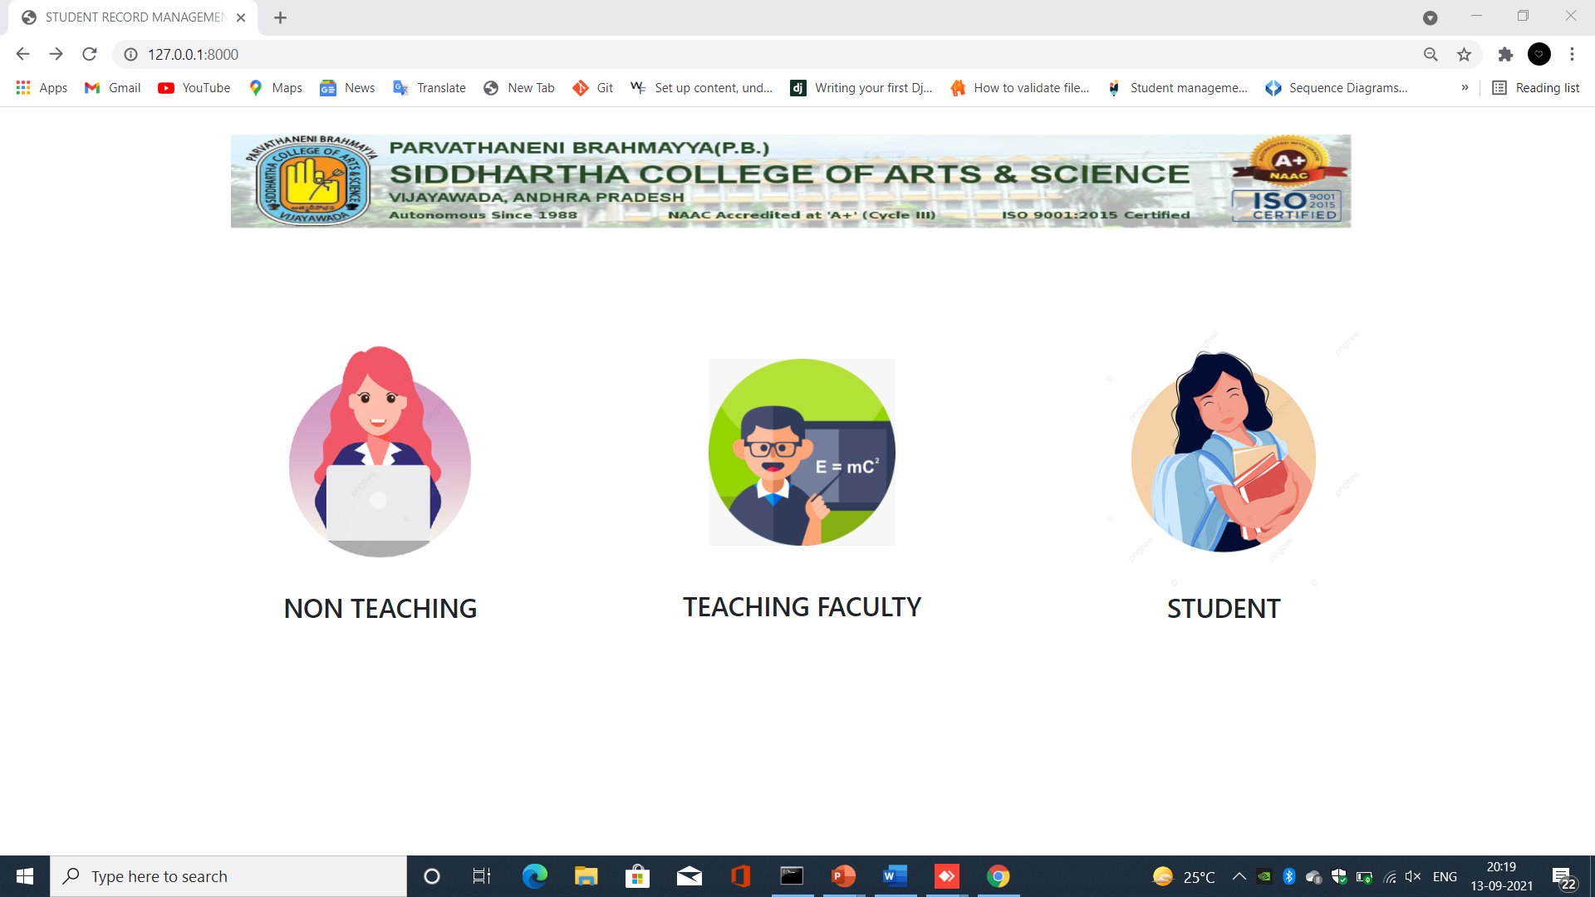
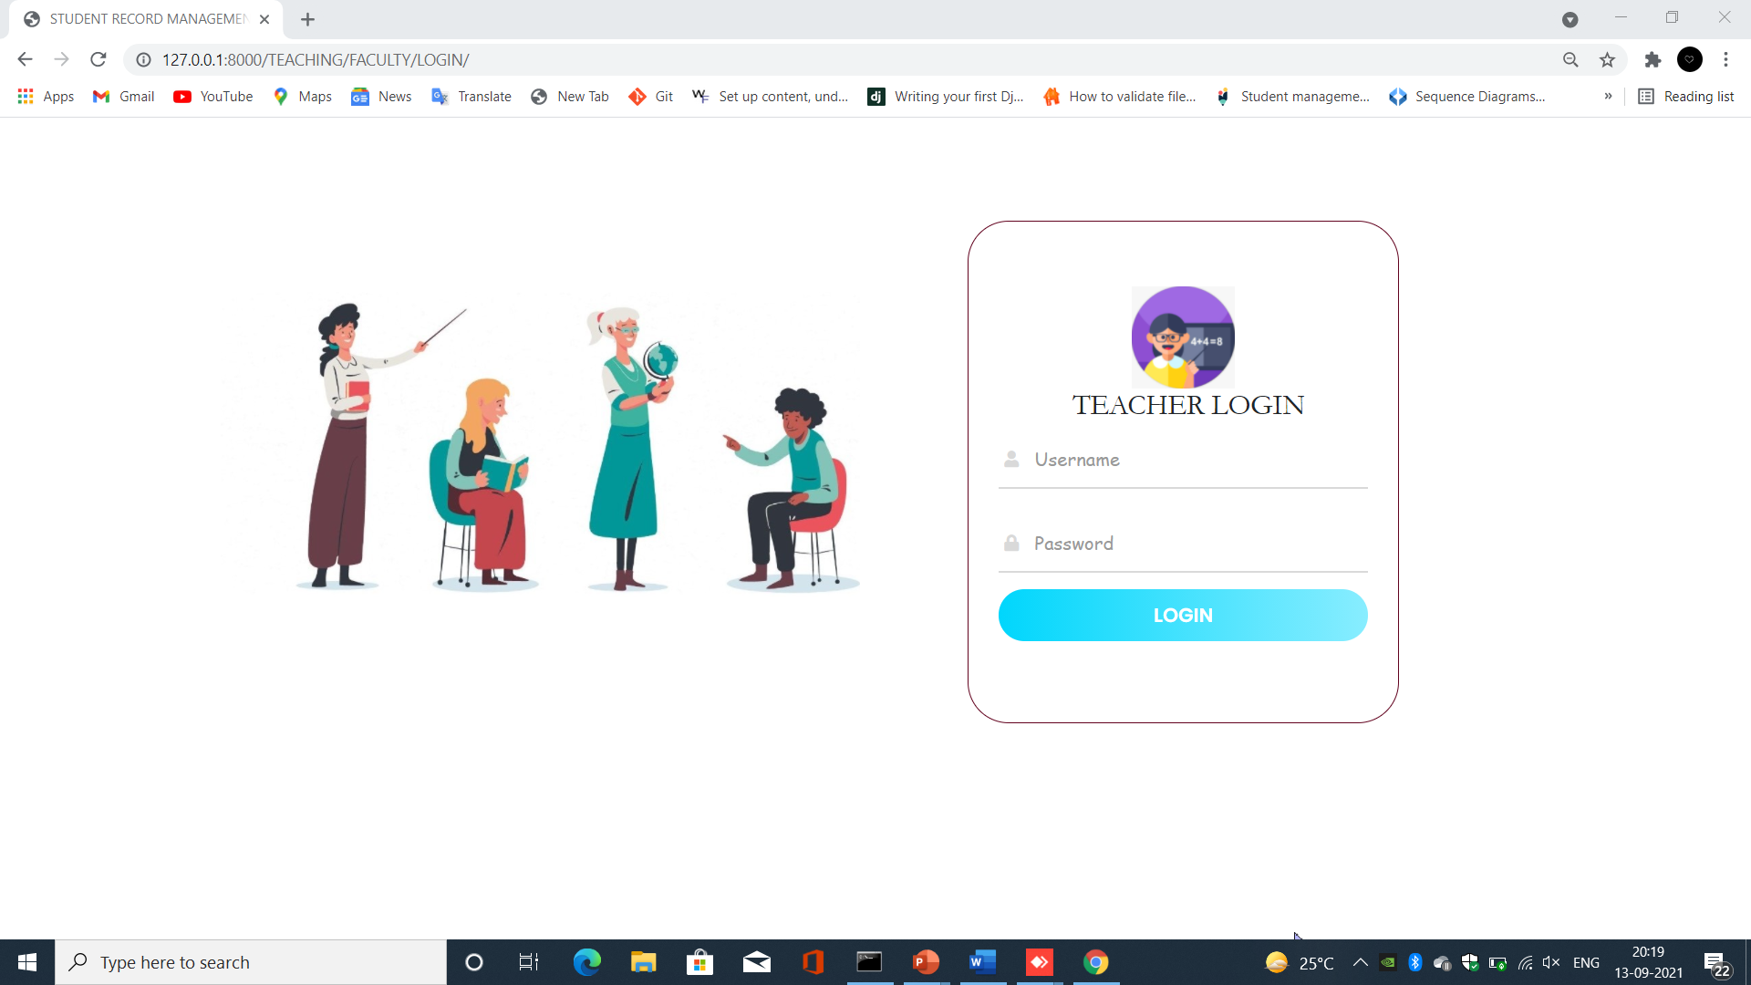
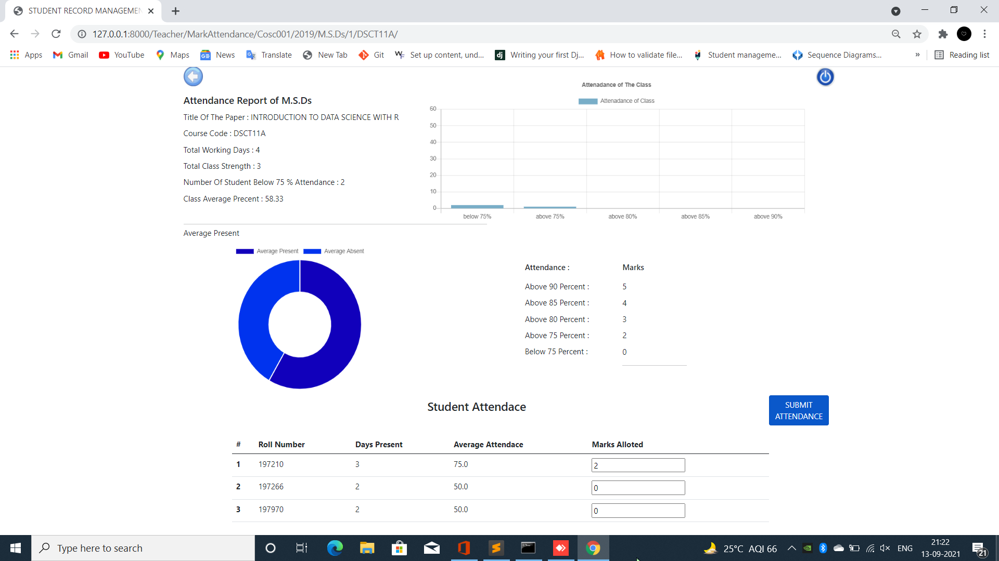
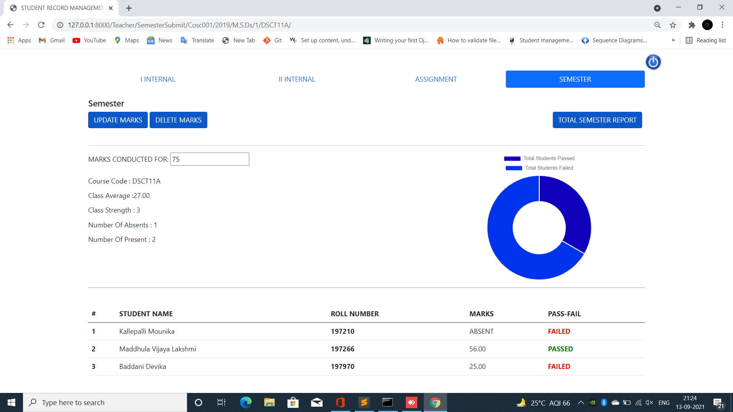

Slide 16
TEST CASES
S.NO | TITLE | EXPECTED OUTPUT | ACQUIRED OUTPUT | RESULT
1 | Faculty login | Should not allow user with incorrect login details | The user with invalid login credentials is not allowed | PASS
2 | Add Student | The student must be added with unique Roll Numbers | Students with the same roll numbers are not allowed | PASS
3 | Student Image | The student image size must less than 300kb | The images with size more than 300kb are not allowed | PASS

Slide 17
S.NO | TITLE | EXPECTED OUTPUT | ACQUIRED OUTPUT | RESULT
4 | Edit Student | All the validations must satisfy | The student details with wrong input are not updated | PASS
5 | Delete student | The Student must be deleted on clicking delete | The student is deleted and the page is redirected to class page | PASS
6 | Certificates | All the student certificates must be displayed in certificates page | The student documents are displayed | PASS

Slide 18
The "STUDENT RECORD MANAGEMENT SYSTEM" helps college personnel to modify the hand-worked understudy record framework with the mechanized program, which works on the accommodation of keeping up with understudy data. The primary functionalities are about controlling the attendance and marks alongside recovering the information regardless of when. This framework additionally upholds in safely putting away the non-excess information for extraordinary periods of time. Understudy record framework helps the client in fast administration of the data with an easy to understand interface given .
CONCLUSION

Slide 19
FUTURE SCOPE
The examinations schedules can be changed depending on the needs.
The student documents can be printed.
The users can change their login credentials.
The teacher can choose the classes for the semester irrespective of the admin permission.
The student can submit their details in the process of registration.
Part 4 details can also be included.

Slide 20
BIBILIOGRAPHY
https://www.google.com/search?q=html+color+mixer&oq=html&aqs=chrome.0.69i59j69i57j69i59l2j0i433i512l4j0i512j46i433i512.3636j0j15&sourceid=chrome&ie=UTF-8
https://undraw.co/search
https://www.flaticon.com/search?word=student&type=icon
https://getbootstrap.com/docs/5.1/getting-started/introduction/
https://docs.djangoproject.com/en/3.2/intro/tutorial01/
https://www.python.org/doc/
https://www.w3schools.com/html/
https://www.w3schools.com/css/
https://stackoverflow.com/questions/tagged/django
https://in.pinterest.com/pin/849139704719724053/

Slide 21
QUERIES?

Slide 22
THANK YOU

